Slide 1
Redesign of AEAC Website
Module 7 Challenge

Slide 2
M7 Challenge: Usability for All Recommendations
Possible Accessibility Issues the target audience may experience are the following,
Vision Impairments
Hearing Impairments
Motor Impairments
To resolve these accessibility issues, my strategy will be to adopt universal design principles in the website design process. By considering the needs of all users including those with disabilities, we can create a website that is accessible to everyone.
Design will include clear and legible fonts to ensure text is readable for users with vision impairments, captions and transcripts for videos to ensure users with hearing impairments can engage, and design the website with focus on keyboard accessibility to ensure users with motor impairments can navigate the website with keyboard-only controls.

Slide 3
M7 Challenge: Planning for Wireframes
Home Page
Resources Page
Events Page
Community Page
About Us
Account Page

Slide 4
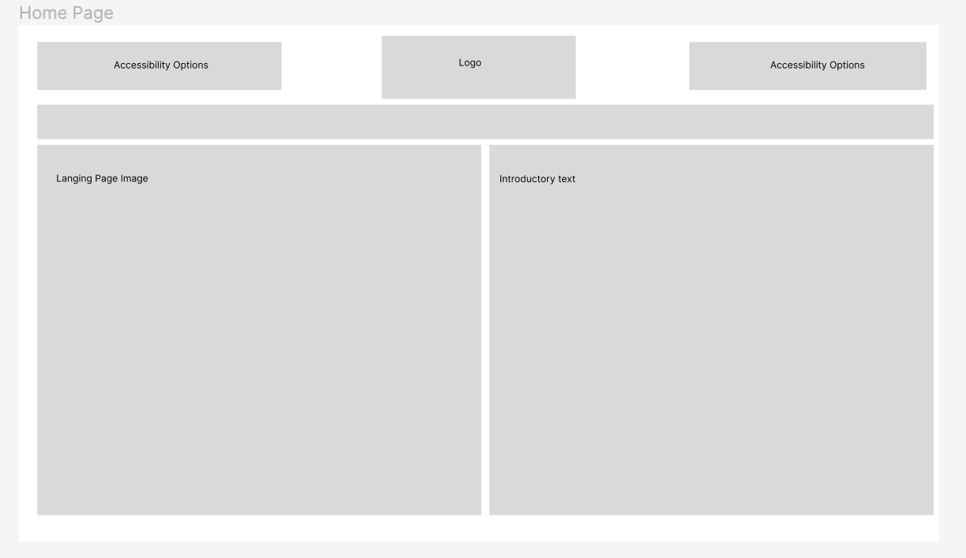
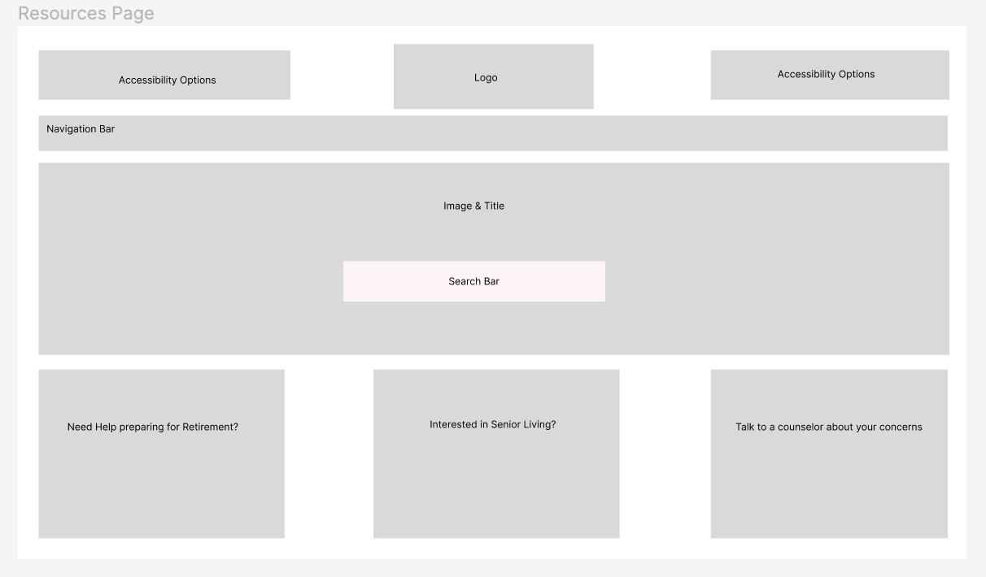
M7 Challenge: Low Fidelity Wireframe I

Slide 5
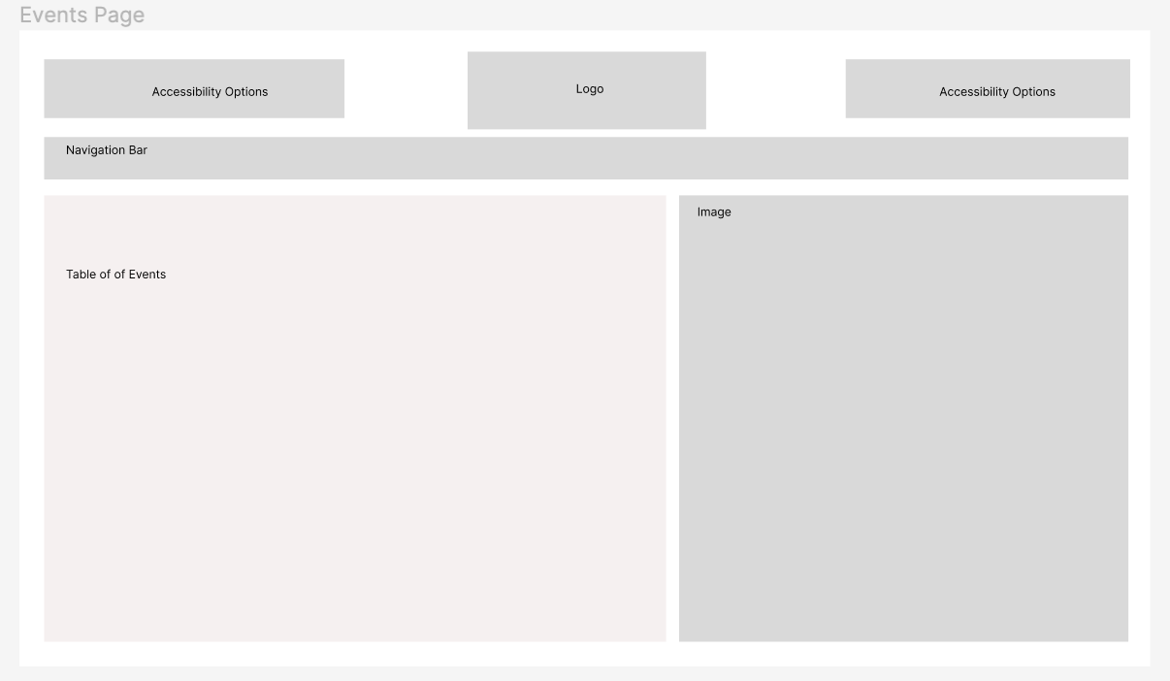
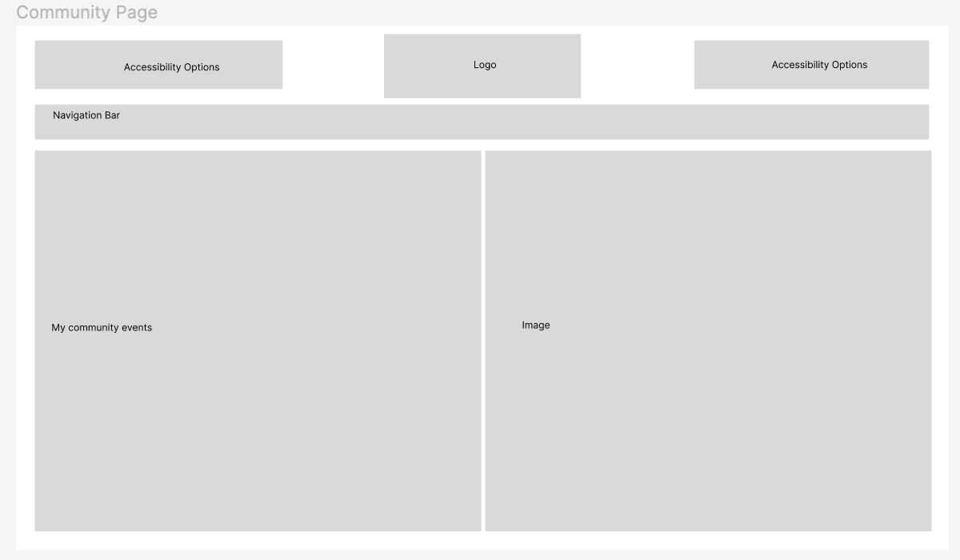
M7 Challenge: Low Fidelity Wireframe II

Slide 6
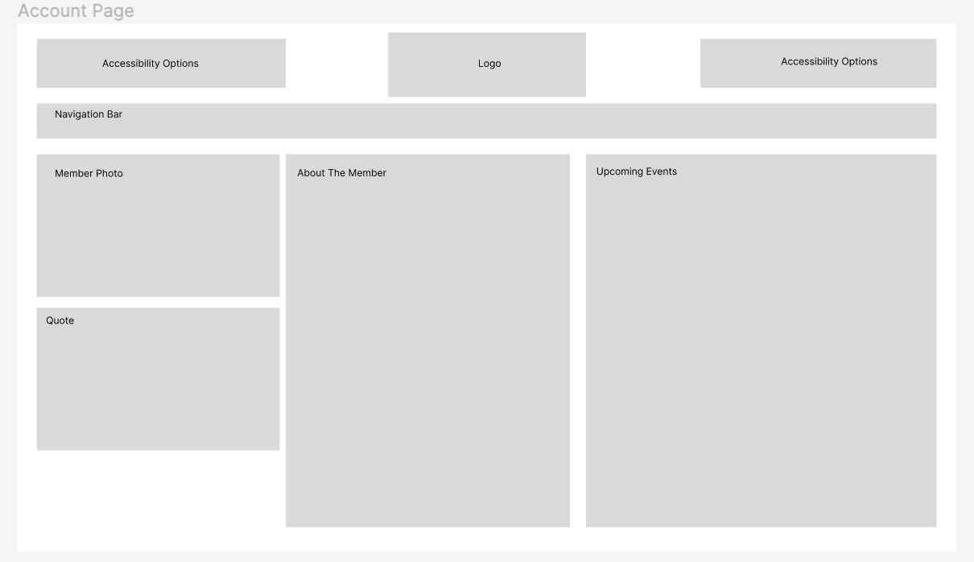
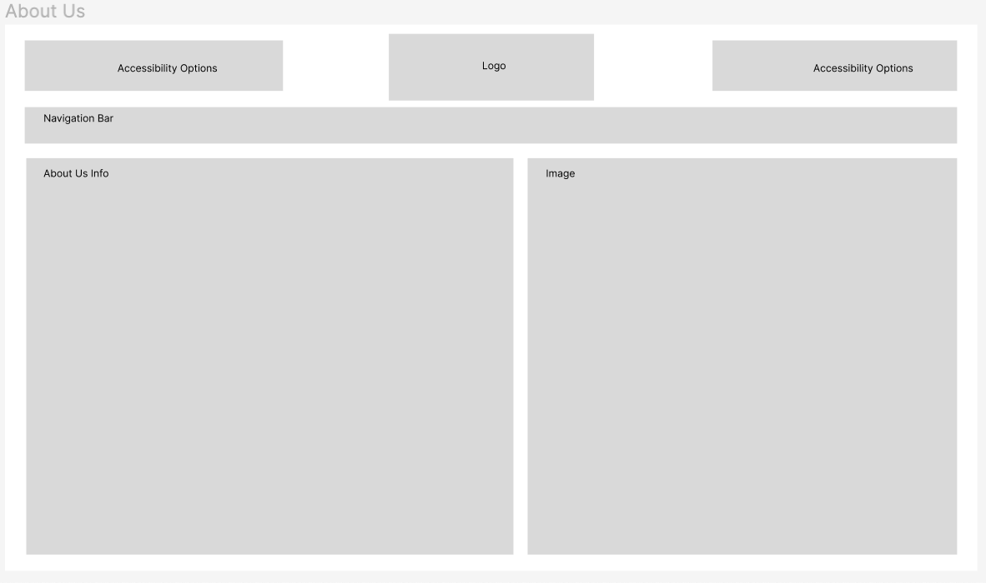
M7 Challenge: Low Fidelity Wireframe III

Slide 7
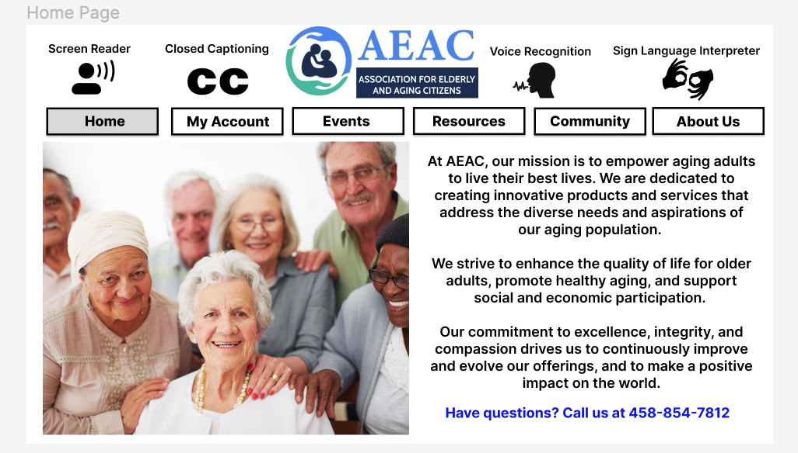
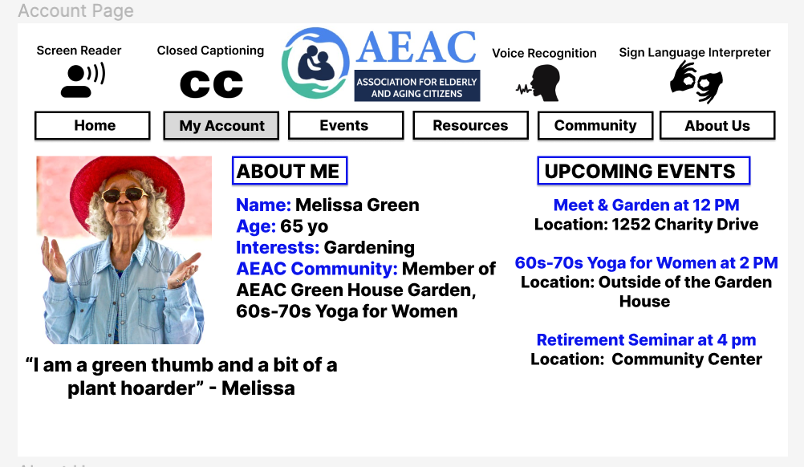
M7 Challenge: High Fidelity Wireframe I

Slide 8
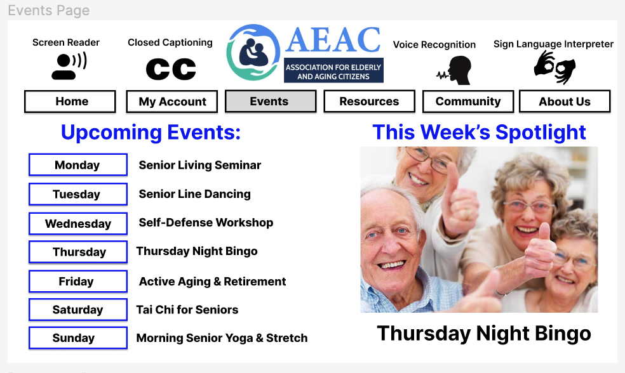
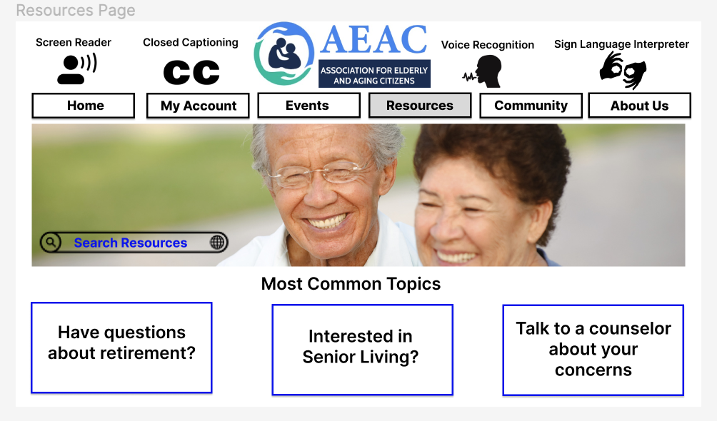
M7 Challenge: High Fidelity Wireframe II

Slide 9
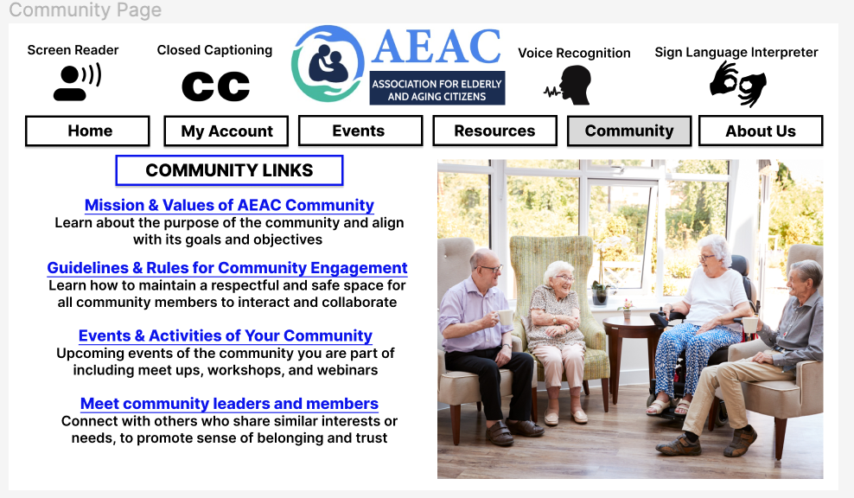
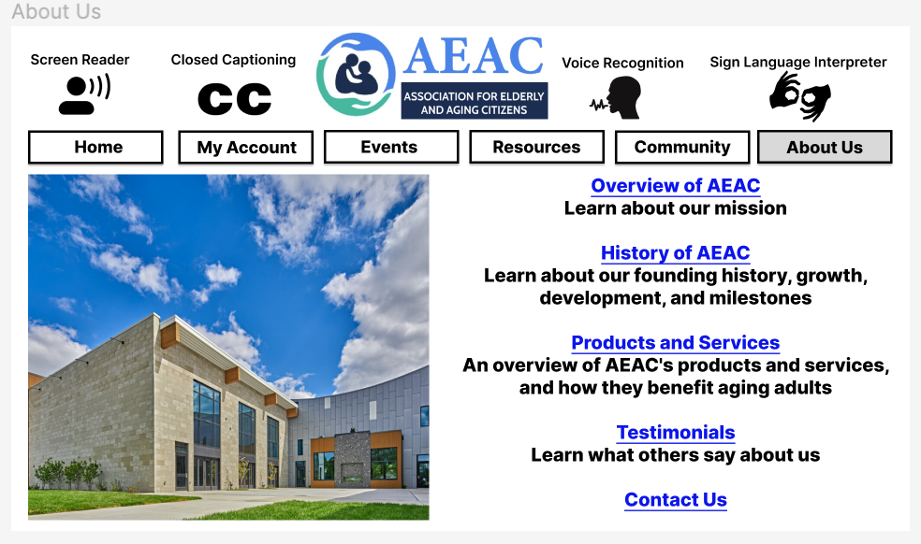
M7 Challenge: High Fidelity Wireframe III

Slide 10
M7 Challenge: High Fidelity Wireframe Prototype
Prototype Navigation:
You can use the navigation panel on each frame of the prototype to navigate to the section that you are interested
You start with the Home Page
Then, you can decide to go with order of the navigation panel or random order to pages including Account, Resources, Community, About us, Events
You can return to the Home Page from all the frames
Link to the prototype

Slide 11
M7 Challenge: Testing Plan
What user-testing technique is most appropriate for the website (e.g., on-the-spot testing, moderated in-person testing, remote testing)?
Combination of moderate in-person testing and remote testing
Why did you choose that technique?
Moderated in-person testing allows the testing team to observe and interact with users directly, providing valuable insights into their thought processes and behaviors as they navigate the website. However, due to the age range of the target audience and potential mobility limitations, remote testing can also be a valuable option. Remote testing allows users to test the website from their own devices and in their own environments, providing a more realistic user experience.
What metrics would you use to determine success?
User engagement, conversion rate, User satisfaction,Accessibility compliance

